Slide 1
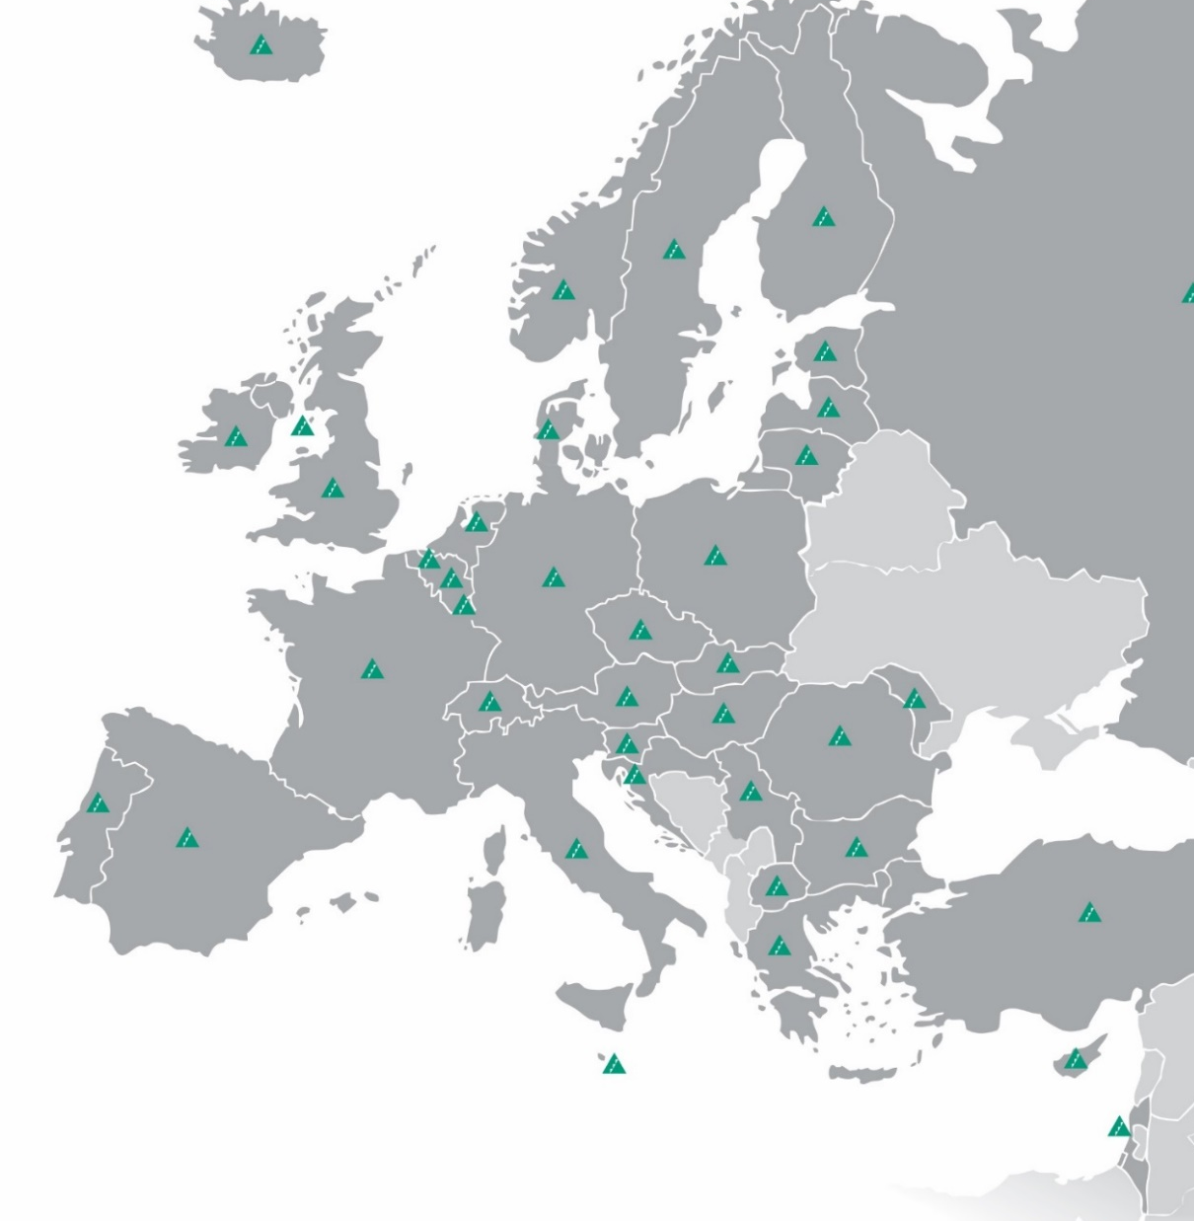
Notes:
Young Enterprise is the UK’s leading charity that empowers young people to harness their personal and business skills. We run a range of enterprise and financial education programmes for young people aged 4 – 25.
Created in the UK in 1963 by merchant banker Sir Walter Salomon, based on the American Junior Achievement programme.
Mission - Our mission statement defines what we do and why we do it. We empower young people to discover, develop and celebrate their skills and potential.
Vision - We believe that young people should be given the best chance for a rewarding future in work and life – no matter where they start their journey.

Slide 2
INTRODUCING
10X Challenge

Slide 3
Do you want to be an entrepreneur?
What is an entrepreneur?
UK entrepreneurs
Young entrepreneurs
Preparing for the 10X Challenge
Preparing your business plan
What happens next?
Competitions and prizes
10AM
12PM
2PM
Name Surname
Name Surname
Name Surname

Slide 4
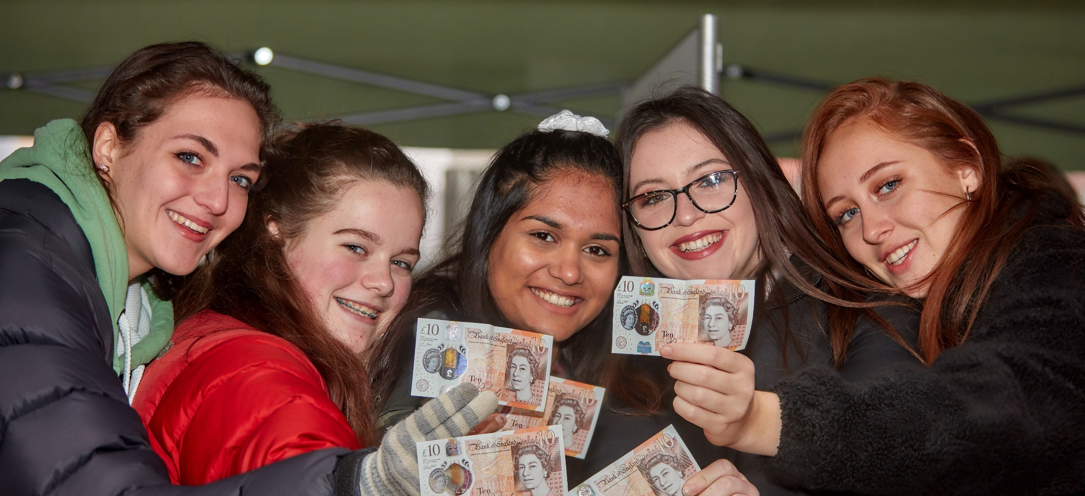
SESSION 1
What is an entrepreneur?

Slide 5
What is an Entrepreneur?
An entrepreneur is a person who sets up a business or businesses, taking on financial risks in the hope of profit.
But what makes a successful entrepreneur?
5 common characteristics of an effective Entrepreneur:
Ambition and self-confidence
Ability to spot opportunities
Willingness to take a risk
Ability to learn from mistakes
Trust in and respect their colleagues

Slide 6
UK Entrepreneurs
?
One British example of someone who embodies the entrepreneurial characteristics is Ben Francis MBE – the owner of Gymshark. Having started the company as an exercise supplement business out of his parent’s garage with his friend, they branched out into clothing using a sewing machine and other equipment he bought using just £1,000 he had saved up. As a start-up, Ben Francis marketed the company through partnerships with social media influencers, including YouTube body builders. Gymshark was one of the first brands to make extensive use of social media influencers.
At 31 he is now worth over £1 billion.

Slide 7
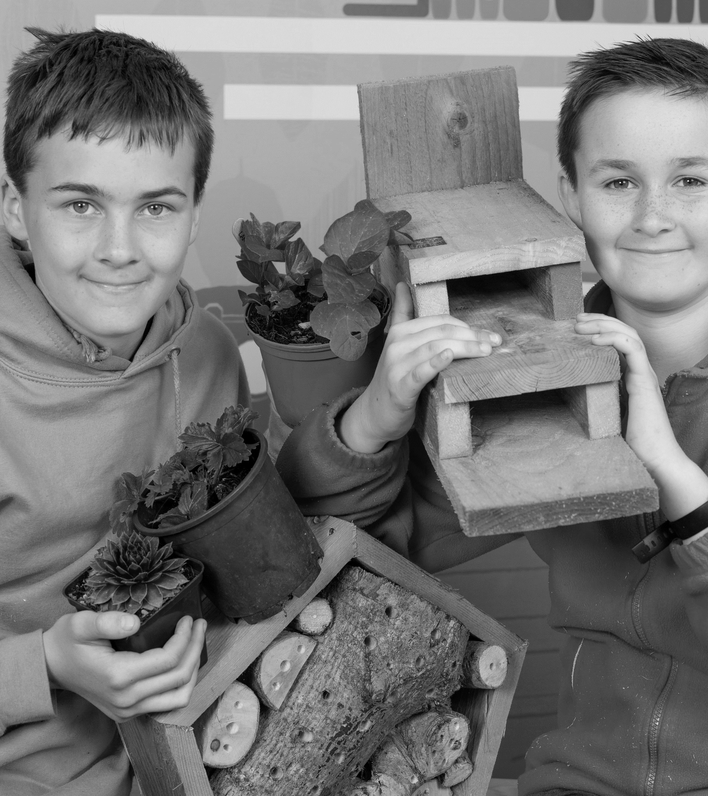
Young Entrepreneurs
Following the Fiver Challenge in 2021, Alex put his learning, experience and taste for entrepreneurship, alongside his brother Tomas, into his own family–run micro-business, Seeder Wood. The pair have continued growing and selling plants and have also expanded into woodwork, making a range of innovative garden items from bird tables to duck houses from scratch. Alex and Tomas have a great passion for sourcing scraps of wood and turning them into something that can be used and enjoyed for years to come.
Notes:
Young Entrepreneurs

Slide 8
Young Entrepreneurs
A team from St. David’s College in Llandudno created Re-use I.T. in response to the problem of e-waste.
They partnered with companies to support the process of recycling, repairing, and re-using old and broken devices, such as laptops and mobile phones.
Re-use I.T. won the 2022 10X ‘Business for Good’ award for their contribution to the community, including donations of refurbished equipment to a local dementia-specialist care home.
Notes:
Young Entrepreneurs

Slide 9
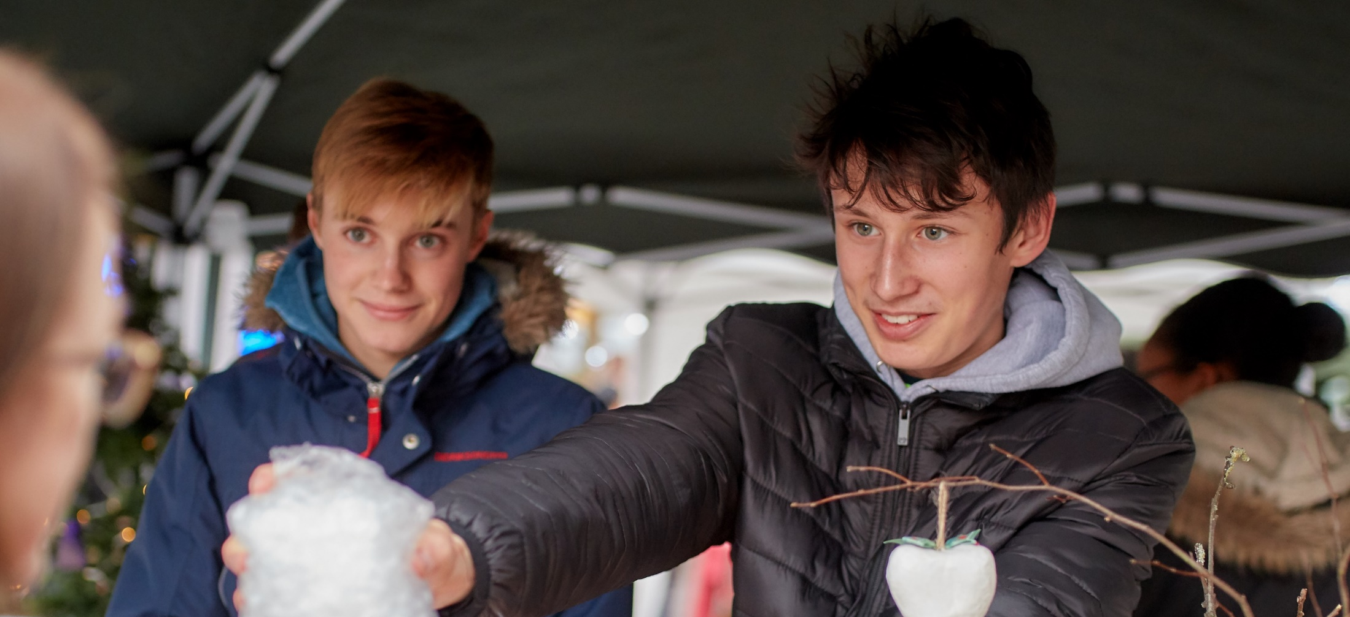
SESSION 2
Preparing for the 10X Challenge

Slide 10
What is it?
?
With just a £10 initial investment and 4 weeks, teams must create, market, organise and financially manage their own business with the intention of making a profit.
Young people can choose to work in a team of up to 8, or by themselves.
There are two weekly competitions and one national competition to enter.
At the end of the challenge, you pay back your £10 plus a £1 legacy contribution from teams who have made a profit.

Slide 11
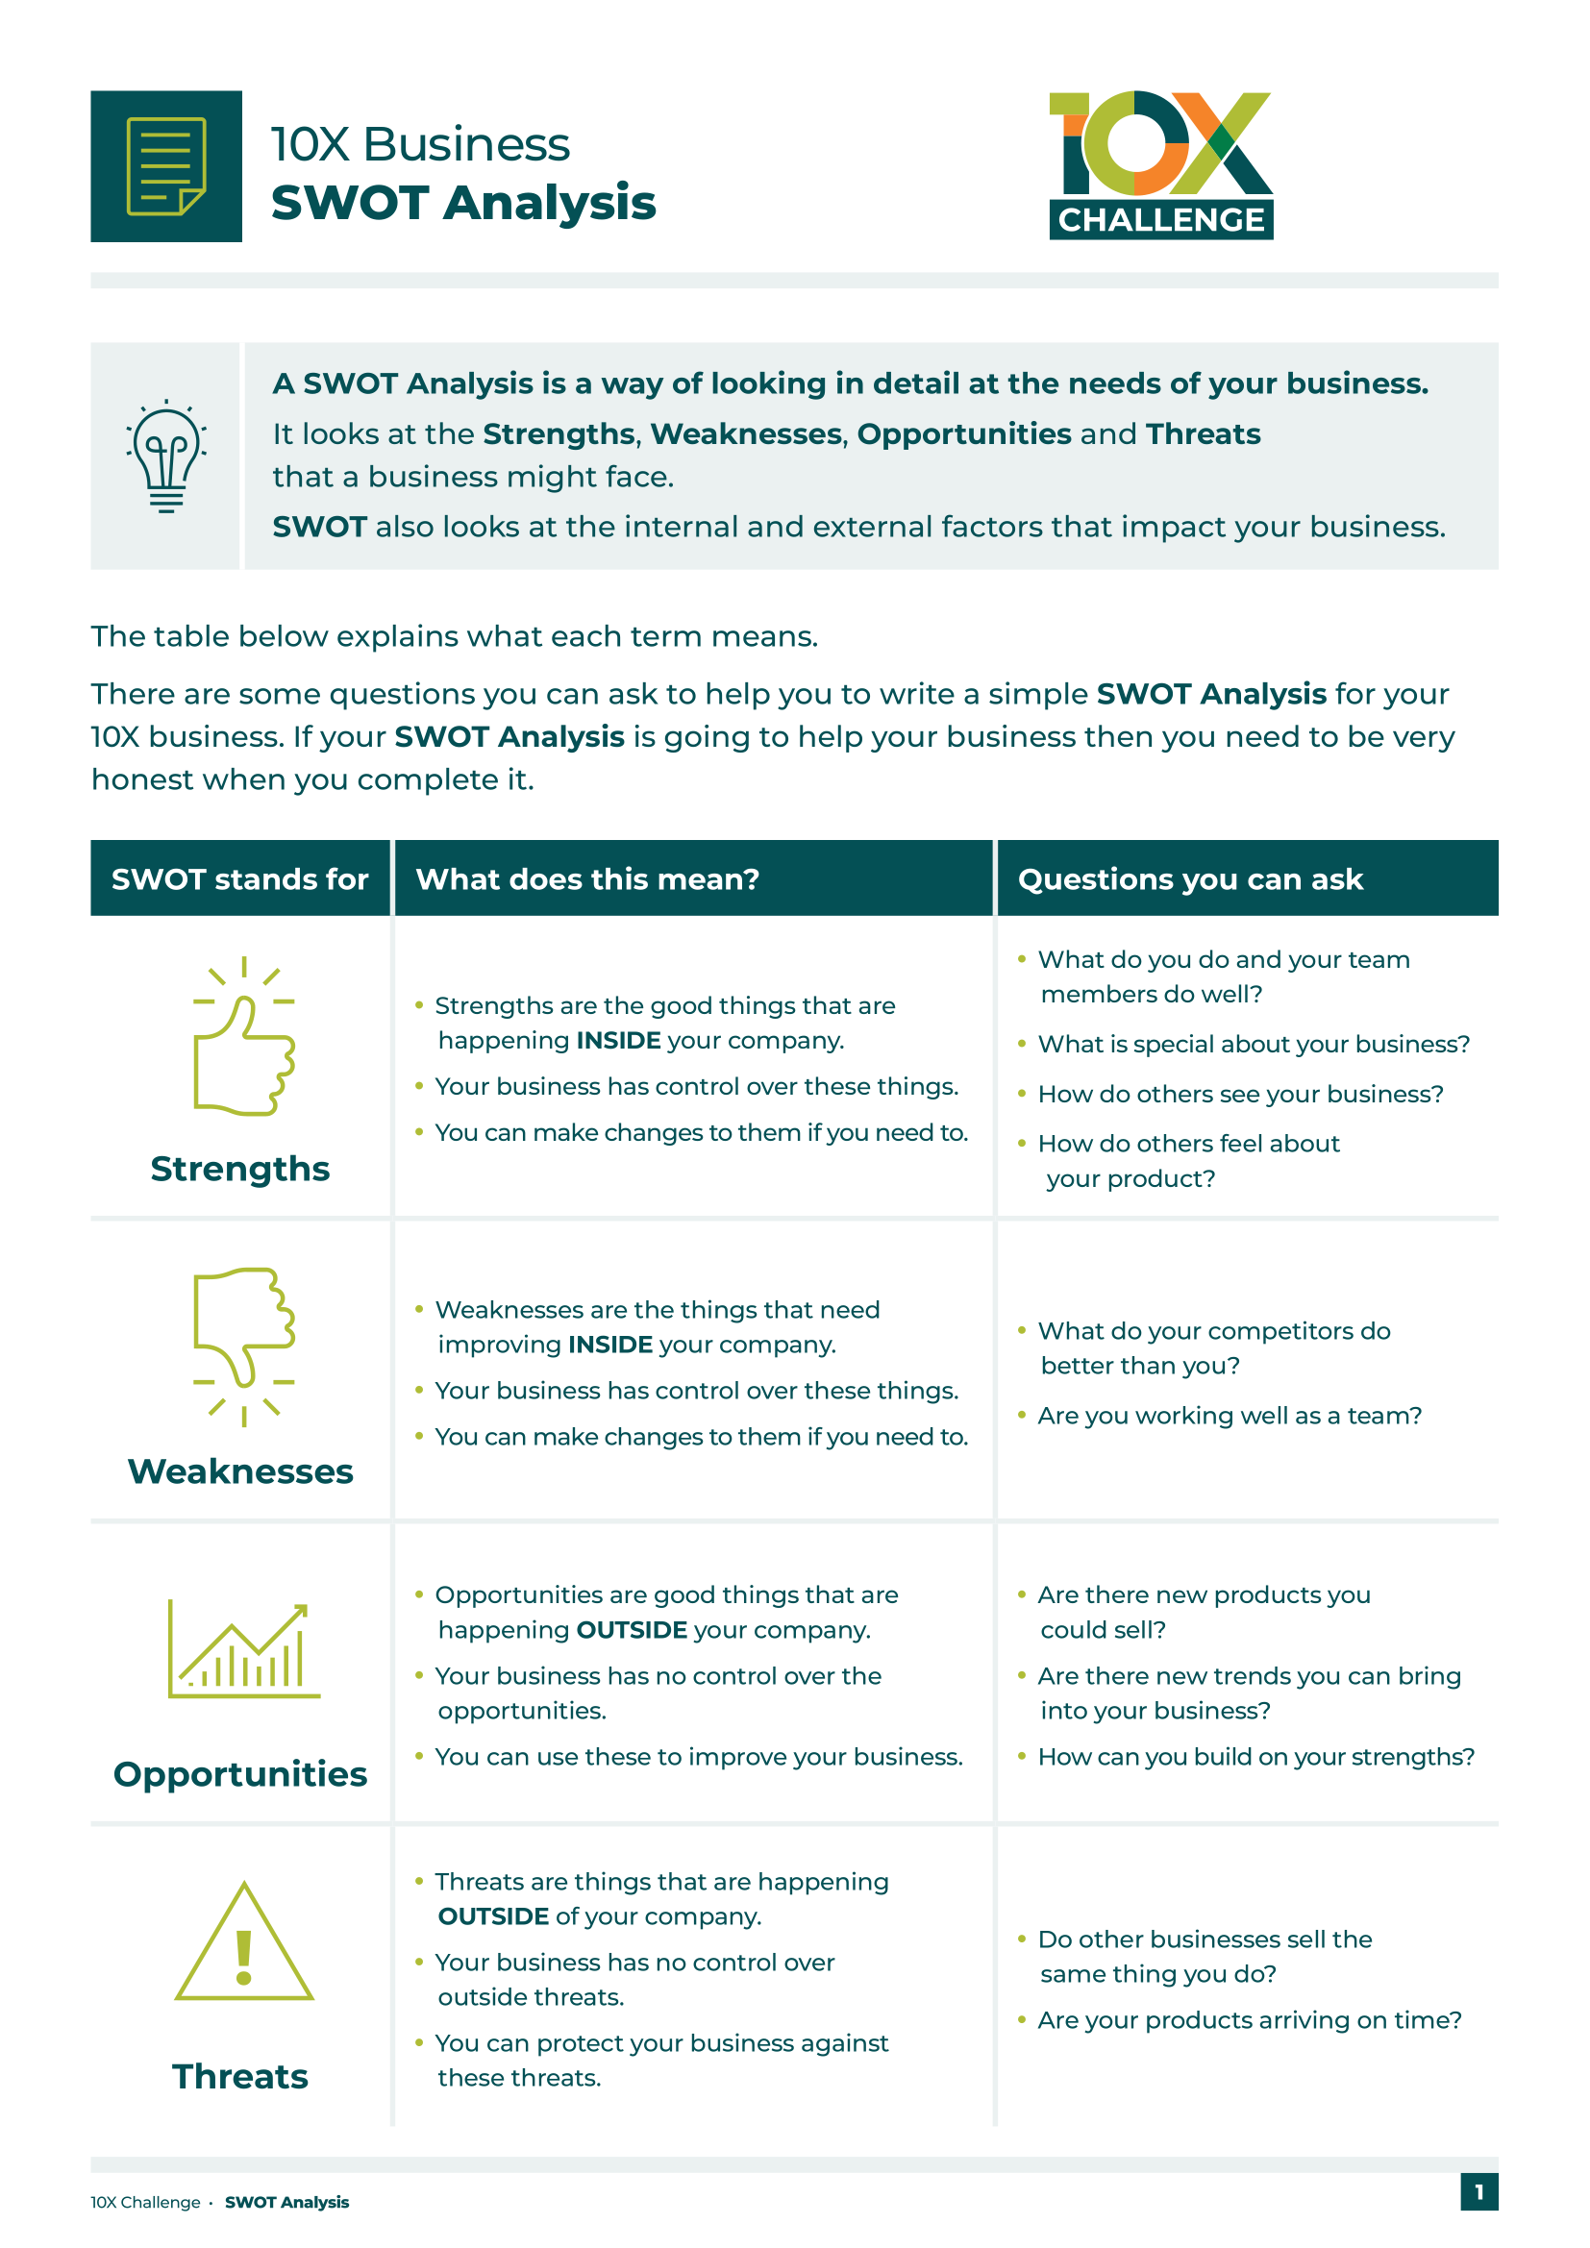
Continued…
Profits are yours to keep and it’s up to you to decide how to spend it.
Supporting materials are available for educators via the 10X Challenge digital platform.

Slide 12
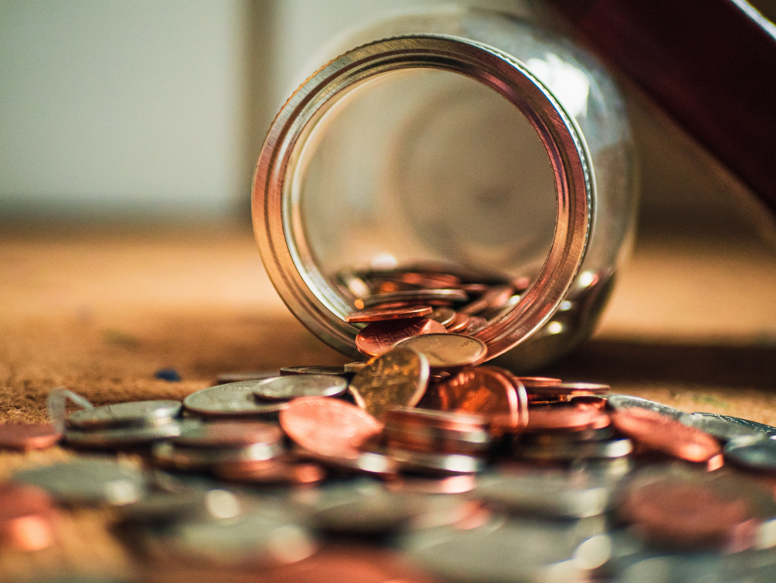
Week 1
Here’s £10!
Teams research and decide on a product or service in which to invest their £10.
Logo Competition

Slide 13
Week 2
Getting Going
Teams need to source materials or products, prepare sales pitches, and plan selling events.

Slide 14
Week 3
Keep It Going!
Teams get their product or service ready and promote their selling events.
Sales Pitch Competition

Slide 15
Week 4
Profits & Pledge
Teams decide how to spend or donate their profit after repaying the initial £10 pledge, plus £1 legacy contribution to support the 10X bank.
National Competition

Slide 16
Week 1
Here’s £10!
Teams research and decide on a product or service in which to invest their £10.
Week 2
Getting Going
Teams need to source materials or products, prepare sales pitches, and plan selling events.
Week 3
Keep It Going!
Teams get their product or service ready and promote their selling events.
Week 4
Profits & Pledge
Teams decide how to spend or donate their profit after repaying the initial £10 pledge, plus £1 legacy contribution to support the 10X bank.

Slide 17
Sustainable Business
In the 10X Challenge, we encourage a sustainable approach to business, rather than thinking solely of profit.
What does sustainability in business mean?
“A business which operates today in a way that values and protects the people, planet and resources it relies on for the future.”
Big changes start small.

Slide 18
United Nations SDGs (Sustainable Development Goals)
Notes:
The Sustainable Development Goals (SDGs), also known as The Global Goals, are a shared agenda to end poverty, fight inequality & injustice and protect the planet. Agreed in 2015 by all countries within UN and set to be completed by 2030.
Are there any opportunities to focus on sustainability with your 10X business idea/service? If so, you could be in with a chance of winning the ‘Best in Sustainability’ prize in the 10X National Competition!

Slide 19
Notes:
A great example of a sustainable business is 2020’s ‘Company of the Year’ award winner: EnviroTent.
Having seen the waste that plastic tents produce, EnviroTent decided to create the first ever cardboard only tent that, whilst having all of the water and windproofing of a regular tent, is also fully recyclable.
They showed a great ability to spot a business opportunity whilst solving a common issue seen across festivals in an eco-friendly way.
Let’s have a look at how they approached their business.

Slide 20
Financial Sustainability
Investment
When a company invests their profits into their business.
Investment has a higher risk but a higher reward if successful.
Examples include machinery, new technology, even acquiring other businesses.
Saving
When a company doesn’t spend or consume their profits but places them into a savings account.
Saving has a much lower risk but also smaller returns.
Notes:
To be financially sustainable in the long run companies use 2 pathways – Investment & Saving:
Investment:
Where a company will invest their profits into something that will help them to make more profit in the longer term e.g. a big marketing campaign to increase brand awareness that will lead to more sales. Investing is slightly riskier but, if successful, can lead to companies growing quickly and making much larger profit.
Saving:
A company may choose to save their profits too in order to ensure that costs can be met if they have a downturn in sales. This is a safe strategy and can help a business during tough times such as many businesses are going through currently.
We as individuals also need to make sure that we are financially sustainable so will save or invest a % of their wages. This helps individuals with their financial goals such as buying a house.

Slide 21
Choosing your 10X business
Product
Maybe hand-made or home-grown? Personalised?
Can you link it to a topic or theme, event or local opportunity?
Service
Using your team to create/offer an activity for a fee?
Examples include car-washing or dog-washing.
How can you make sure you profit from your £10?
Notes:
Getting started…
Firstly, you’ll need to think of what you will be selling – will it be a product or service? You must read and comply with 10X terms and conditions to make sure your business is in line. (Refer to the Product Guidelines sheet)
To make a profit from your product or service you will need to add value to your product or service.
Added value is the difference between the cost of inputs and the price customers are willing to pay.
2 ways to add value are:
Reducing your costs in an intelligent way can do this whilst keeping the quality of your product or service high e.g. using vegetables from your own garden is free
Another way is to have a high price e.g. products and services that are in high demand tend to be more expensive – however if you charge too much customers may not buy it.
Find out more from your customers. Market research is a great way to find out what potential customers think of your product or service. This is a valuable tool that can help you to make decisions about your business.
Now you have your business idea and know that it will make a profit and customers will buy it, you will need to move onto your business plan.

Slide 22
What’s in a name?
It’s important to choose a name and logo…
That represents what the business does.
That is memorable.
That is unique (we don’t want copyright or brand infringements!).

Slide 23
Resources & Finance
Questions to answer when setting up your business:
Where will you find or buy your materials/resources?
Who can you approach for support?
How much will they cost? Can you negotiate?
What will it cost to deliver these materials?
How much time does it take to make your product?
Is your selling price flexible? Added value? Discounts for multibuy?

Slide 24
Sales & Marketing
How can you promote your product or service?
Social media, posters or word of mouth?
Pop-Up Shop or join an event?
Sell at a local market?
Contact your local community and press?
Local radio?

Slide 25
Weekly Competitions
Award Categories
Logo Competition (Week 1)
Sales Pitch Competition (Week 3)
Prizes
The winning team will win a £50 voucher, plus £100 for their school or organisation.
The runner up will win a £25 voucher, plus £50 for their school or organisation.
Both entries will feature in the 10X Challenge Showcase!

Slide 26
National Competitions
Age Categories
11-14
15+
Award Categories
Best Overall Business
10X for Good
Best in Sustainability
Most Inspiring Individual
Prizes
The winning team will win a £50 voucher, plus £100 for their school or organisation.
Winners will feature in the 10X Challenge Showcase!
Notes:
Entry for the National Competitions is split into two different age groups (11-14 and 15+), meaning there are two of each award.

Slide 27
Best Logo 2023 Winner (Left) & Runner Up (Right)

Slide 28
Best Sales Pitch 2023 Team Rock-It

Slide 29
Challenge Dates
29th Apr – 24th May 2024
Challenge runs
5th May 2024 (12am)
Logo Competition deadline
19th May 2024 (12am)
Sales Pitch Competition deadline
2nd Jun 2024 (12am)
National Competition deadline

Slide 30
info@10xchallenge.org.uk
Register for the challenge!

